Slide 1
SENSOR-BASED DATA ANALYSIS PLATFORM FOR SMOKING DETECTION
Faculty of Automation and Computer Science
Computer Science Department
Distributed Systems Research Laboratory
http://dsrl.eu
Author: Rares Tudor RUS
Coordinator: Lecturer Dr. Eng. Marcel ANTAL
Cluj-Napoca, Romania 06.07.2022

Slide 2
Agenda
Context and Motivation
Objectives
Related Work
Solution
Implementation
Experimental Setup
Experimental Results
Conclusion and Further Developments
Bibliography
2

Slide 3
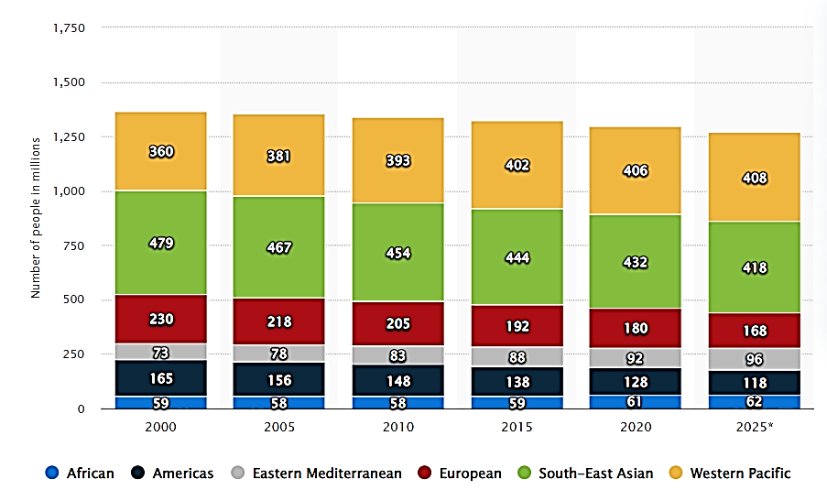
Context and Motivation
Smoking kills approximately 5 to 6 million people every year. On the basis of current smoking patterns, the number of annual deaths due to smoking will rise to around 10 million by 2030. [1]
Number (in millions) of tobacco smokers

Slide 4
Objectives
Main objective:
Develop a method for recognize human activity, for smoking and other similar activities, and implement it as a distributed system for assisting people to quit smoking.
Secondary objectives:
Study already existing approaches.
Design and implement the support system for smoking detection.
Integrate the human activity recognition component with the rest of the platform.

Slide 5
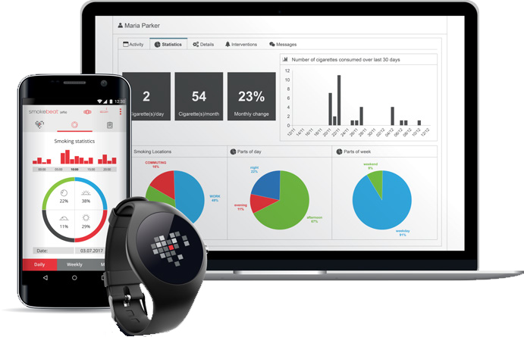
Related Work
A Hierarchical Lazy Smoking Detection Algorithm Using Smartwatch Sensors[3] University of Twente, The Netherlands
Advantages: Classification of 5 different types of smoking.
Disadvantages: Low accuracy because they use only 2 sensors. No user interface.
SmokeBeat [2]
Advantages: Presentation of financial data and locations where smoking was done
Disadvantages: The need to purchase a specific wrist device.

Slide 6
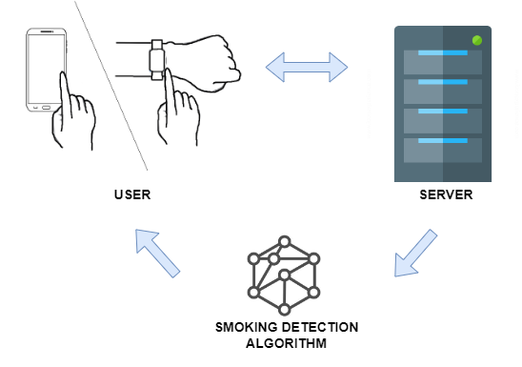
Proposed Solution
A system that takes data from the sensors of a smartphone or smartwatch and processes it to detect smoking.

Slide 7
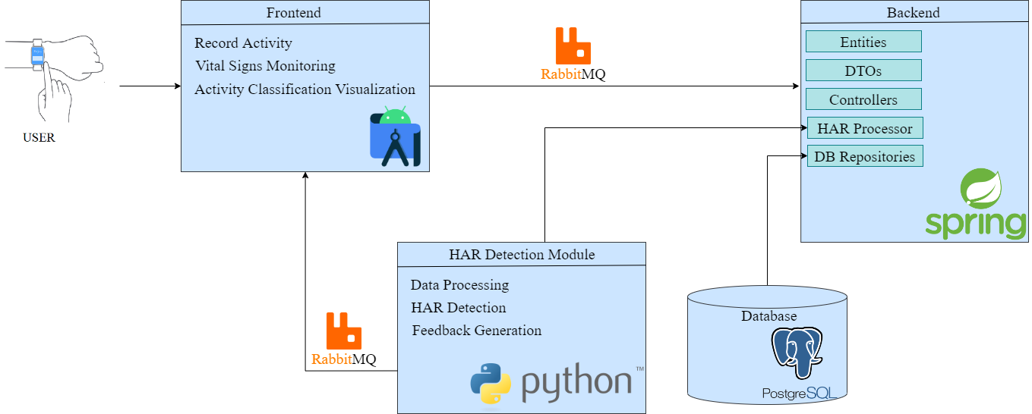
Conceptual Architecture
Front-end component implemented in Android Studio.
Back-end component implemented using Java and Spring.
Human activity recognition(HAR) component implemented in Python
PostgreSQL relational database.
To communication between components we used a queue system.

Slide 8

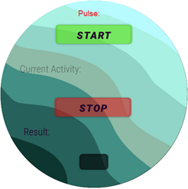
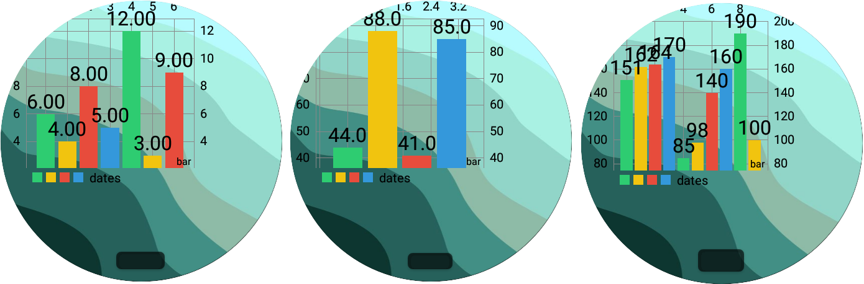
Front-end Component
Home page
This component has the role of sending data to the server and displaying data from it.
HAR page
Smoking Activity History page

Slide 9
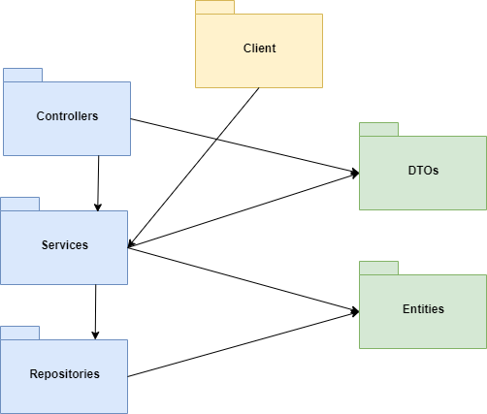
Back-end component
Receives data from client and sends data to it, using queues.
Interacts with the system database.
Sends the data received from the client to the classification component.

Slide 10
HAR component
Continuous communication with the server via a socket.
Continuous data predicted by a model using a fixed window.
Send the classification results to the client side via a queue.

Slide 11
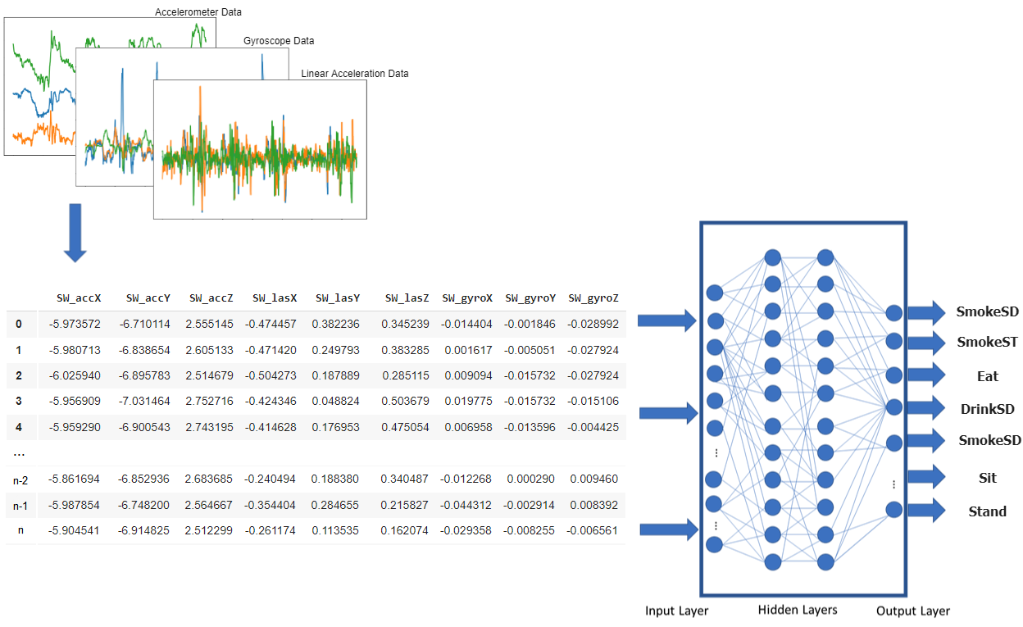
Smoking Detection Algorithm
Input: 100 x [accX, accY, accZ, gyroX, gyroY, gyroZ, lasX, lasY, lasZ]
Output: 7 probabilities.

Slide 12
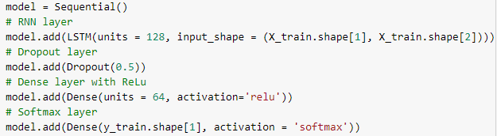
Smoking Detection Algorithm
Layer 1: The first layer is a LSTM layer for learning from sequence of 100 points.
Layer 2: Used as a regularization technique to reduce overfitting.
Layer 3: From this layer onwards the classifier part is starting.
Layer 4: This is SoftMax layer, that predicts the probability corresponding to each activities.

Slide 13
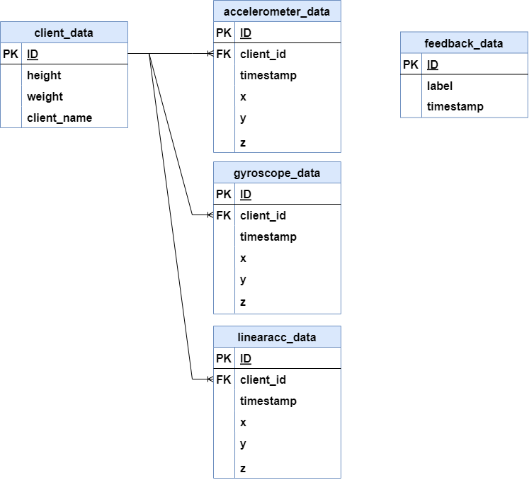
Database

Slide 14
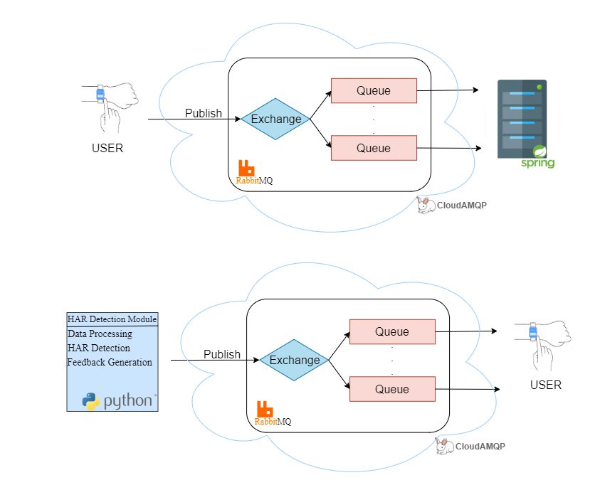
Communication

Slide 15
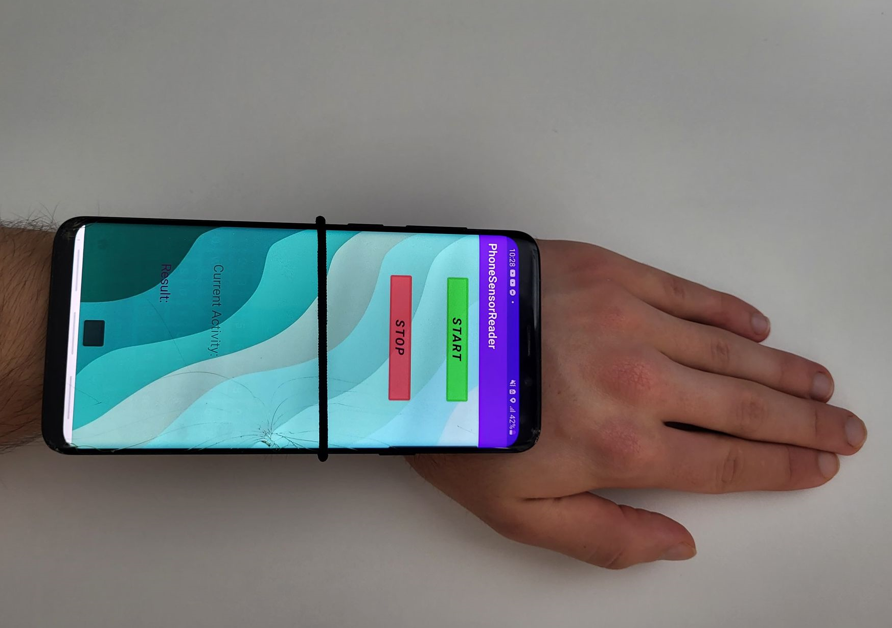
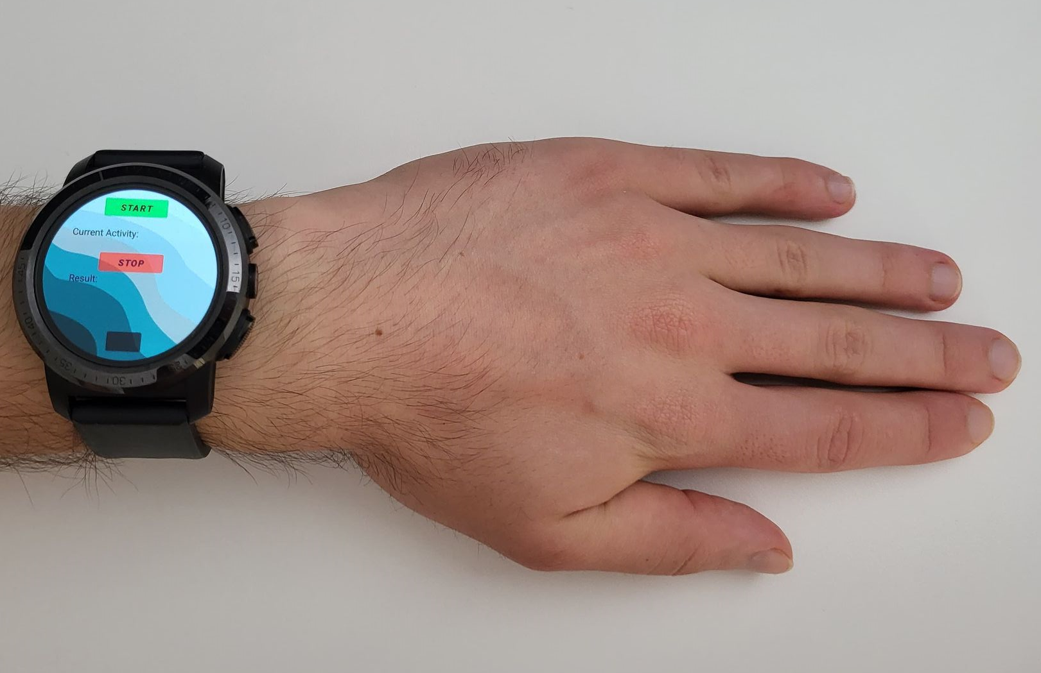
Experimental Setup
Install android application on Smartwatch & Smartphone.
Provide a working internet connection.
Place the smart devices in the appropriate
place [4].

Slide 16
Experimental Results
We used two devices to test the accuracy of the model:
A smartphone, using 3 sensors: accelerometer, gyroscope and linear acceleration sensor.
A smartwatch, using only an accelerometer.
 | Smartphone Accuracy | Smartwatch Accuracy
Participant 1 | 0.94 | 0.92
Participant 2 | 0.92 | 0.87
Participant 3 | 0.94 | 0.91
Participant 4 | 0.89 | 0.87
Participant 5 | 0.94 | 0.89

Slide 17
Conclusion
Obtained results:
Developed a system that distinguishes smoking from other human activities.
Creating an application for smart devices that assisting people to quit smoking.
Future improvements:
Integration a method to warn the user that they smoke too much.
Adding a page for information on the damage caused by smoking and a hotline for emergencies.

Slide 18
Bibliography
[1] Jha, Prabhat. "Avoidable global cancer deaths and total deaths from smoking." Nature Reviews Cancer 9.9 (2009): 655-664.
[2] SmokeBeat highlights, https://www.medgadget.com/2018/05/smokebeat-uses-fitness-bands-and-smartwatches-to-detect-smoking-interview-with-ceo-of-somatix.html
[3] Shoaib, Muhammad, et al. "A hierarchical lazy smoking detection algorithm using smartwatch sensors." 2016 IEEE 18th International Conference on e-Health Networking, Applications and Services (Healthcom). IEEE, 2016.
[4] Justa, Josef, Václav Šmídl, and Aleš Hamáček. "Fast AHRS filter for accelerometer, magnetometer, and gyroscope combination

Slide 19
Thank You!

Slide 20
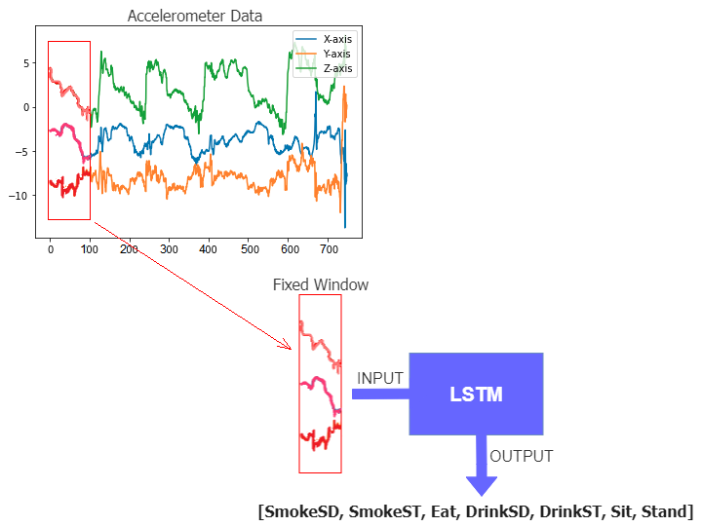
Smoking Detection Algorithm
The values produced by the sensors are analyzed using a window size of 100 points.

